Slide 1
RC Racing TV / EFRA 2012
Season Report

Slide 2
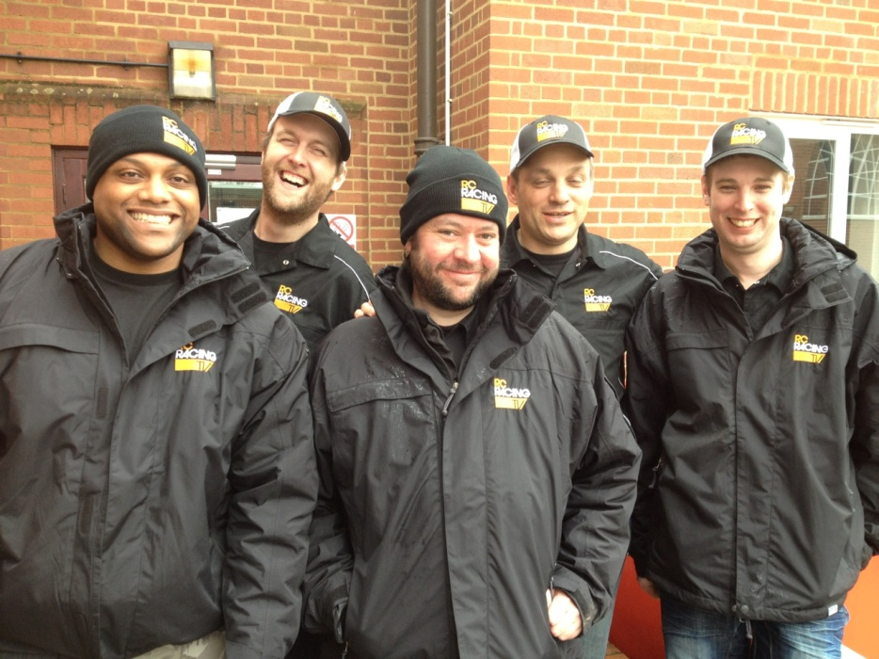
2012 European Tour!
Team of 7 Covered 13 Events!
Live Streaming from 6!
We went to – Monaco – Switzerland
France - Austria – Spain – Holland
Great Britain – Portugal – Austria
Italy – Spain!
Worldwide TV and Internet Coverage!

Slide 3
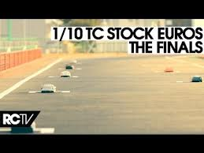
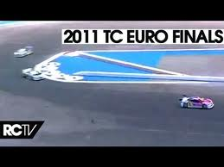
RC Racing – Videos!
You Tube Channel Now at 10 Million Views- 5000 Subscribers!
This Season 71 Videos and Live Streams - Already 263,000 views !
2010-2011 EFRA Videos now have 1,700,000 Views!!!

Slide 4
RC Racing TV
Motors TV – The home of RC Racing TV
7th Series Starts in December!
Features all EFRA “A” Events
4 World championships!
Reach of over 107 Million in 45 countries!

Slide 5
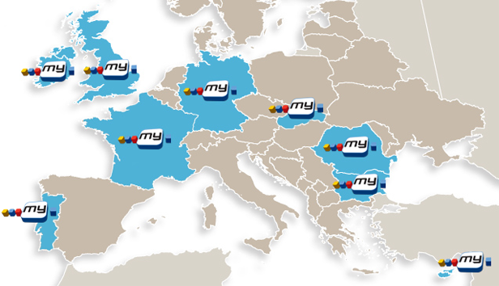
RC Racing TV – New Carrier!!
Back Catalogue Distribution Deal
Will show Series 3, 4, 5 and 6 of RC Racing TV in the New Year!
My Channel in 11 countries and over 23 Million homes!
General Entertainment channel!!

Slide 6
What were our Plans for 2012?
The RC Racing TV Website
Getting Started Guidance
Getting Started Videos
Live Streaming
World championships

Slide 9
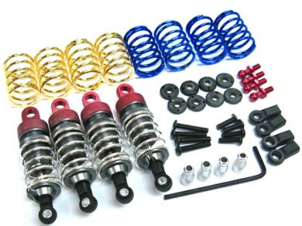
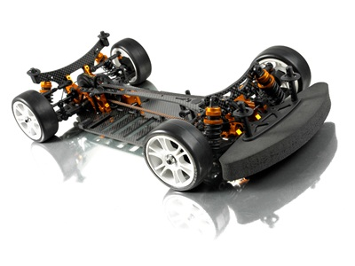
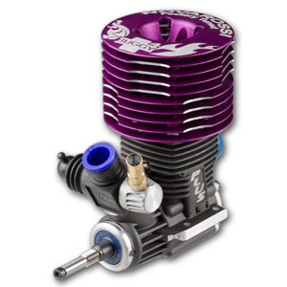
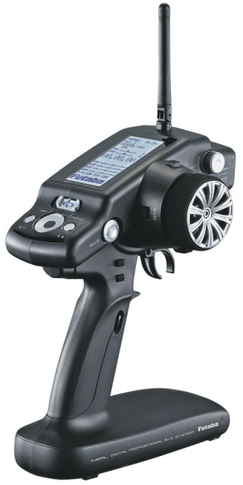
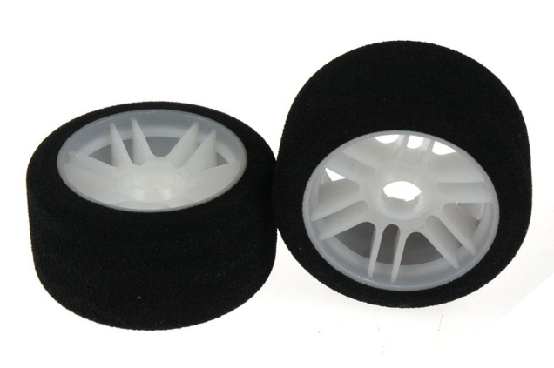
Getting Started Videos!
In Production Now
Released early 2013
New Structure
Will be Multi- Lingual
HD

Slide 10
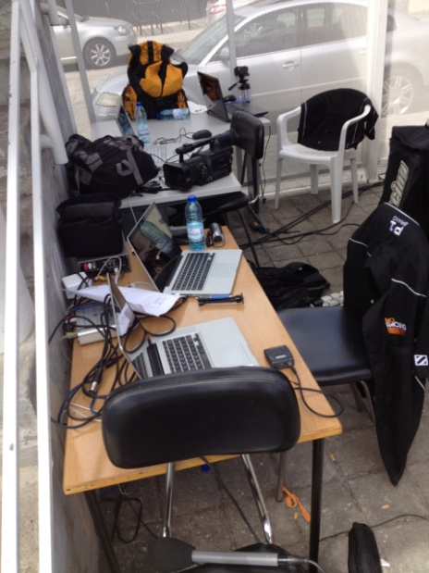
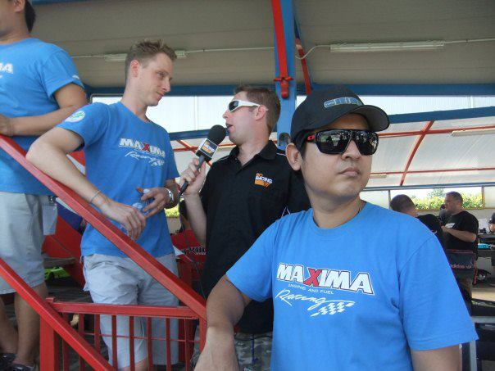
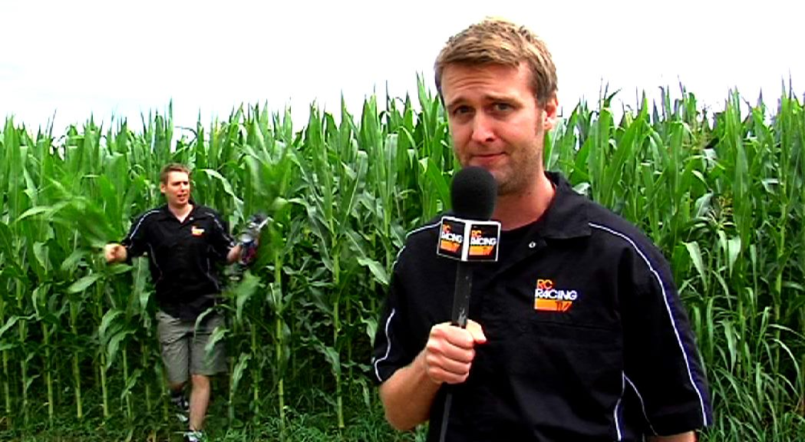
Live Stream!!!
6 Events Live Streamed.
Over 100 Hours of Broadcasting
Multiple Internet Hosts!
Race commentary, Interviews, Updates and even Dispute resolution!!
All Events Fully Archived on You-Tube

Slide 11
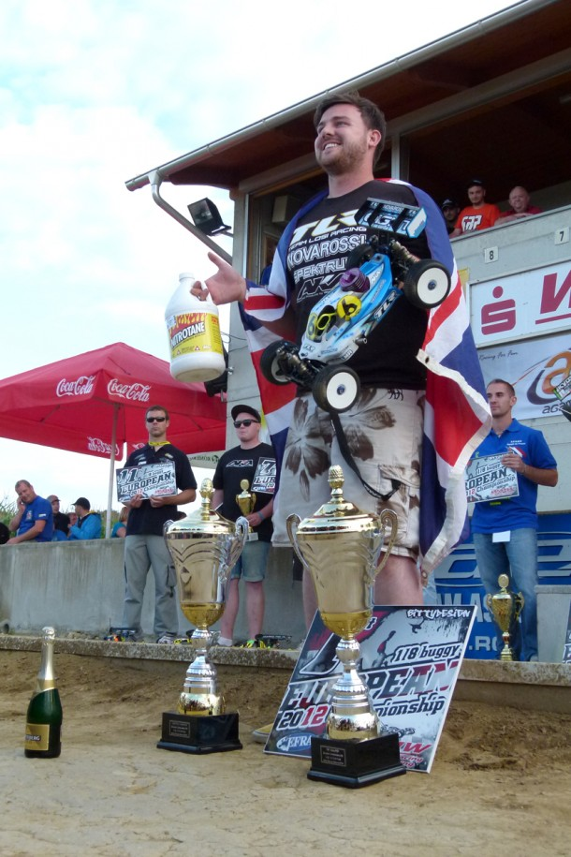
RC Racing TV Live Stream
Darren Tlr Bloomfield
August 14 near Dorney, United Kingdom via mobile
As it sinks in and the kind words and messages start to slow down, I would like to take this moment to thank everyone who was behind me, whether it was trackside at the Euros, at home on the PC or even round Asda doing the weekly food shop streaming on your iPhone, all the support was incredibly confidence boosting. Darren Bloomfield European champ 2012 :)
Always Free to View for the Whole World to See Great RC!

Slide 12
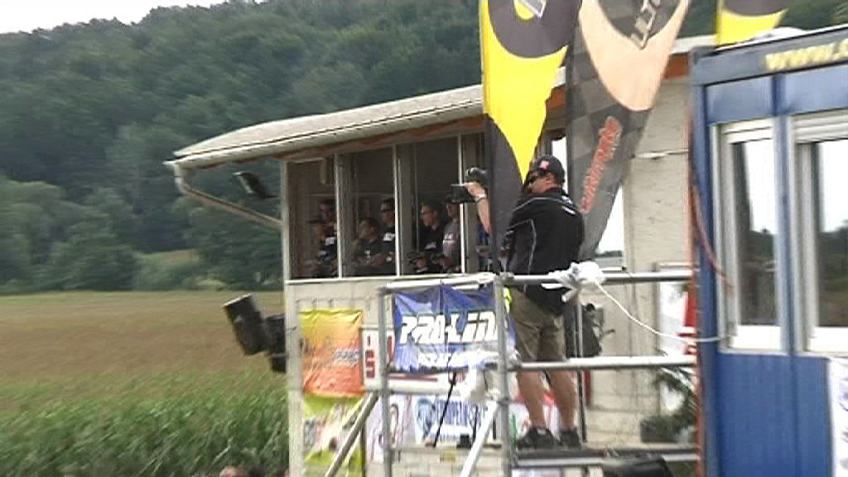
Live Stream – Organisers Notes!!
A Dedicated Connection!
At least 1 Meg Upload Speed!
(Wired, Wireless or 4G!)
A Camera Rostrum within 20M of our “Hub”
2 x 2M Tables within the Media “Hub”
Beer!! ☺

Slide 13
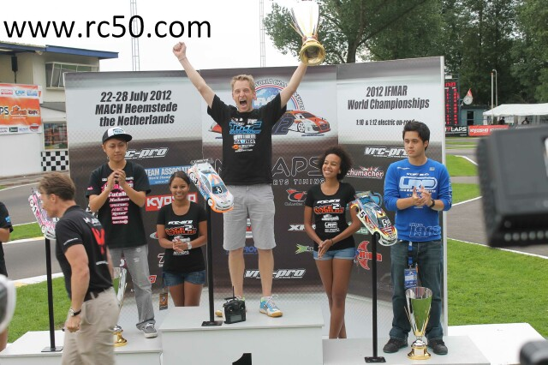
World Championships!
IFMAR 12th and ISTC in Holland covered in Association with EFRA
1/8th Off Road Buggy - will feature in RC Racing TV show

Slide 14
World Championships – Announcement!
RC Racing TV Will be Live Streaming the 2012 IFMAR 1/10th IC World Championships from Bangkok
Free For All!
Anywhere in the World!
No Queues, No Premium Passes!!!

Slide 15
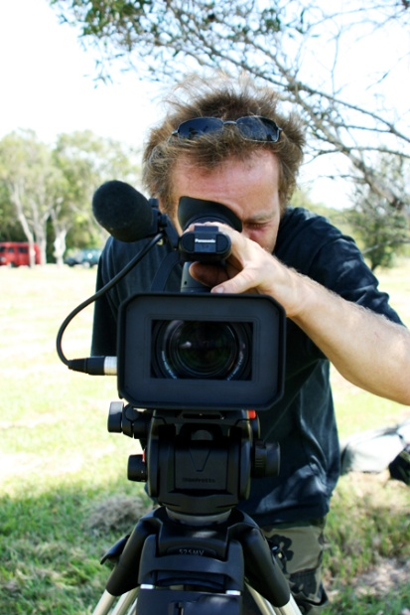
Plans For 2013!
Live Stream Improvements and Innovations!
HD For TV and Videos!!
World Championships!

Slide 16
Questions ?

